Slide 1

Managing State Explosion Through Runtime Verification
www.gigascale.org
Sharad Malik
Princeton University
Gigascale Systems Research Center (GSRC)
Hardware Verification Workshop
Edinburgh
July 15, 2010

Slide 2
Talk Outline
Motivation
Micro-Architectural Case-Studies
Connections with Formal Verification
Summary

Slide 3
Increasing Design Complexity
Moore’s Law: Growth rate of transistors/IC is exponential
  Corollary 1: Growth rate of state bits/IC is exponential
  Corollary 2: Growth rate of state space (proxy for complexity) is doubly exponential
But…
  Corollary 3: Growth rate of compute power is exponential
Thus…
  Growth rate of complexity is still doubly exponential relative to our ability to deal with it

Slide 4
Decreasing First Silicon Success
Source: Harry Foster

Slide 5
Increasing Functional Failures
Failure Diagnosis
Source: Harry Foster

Slide 6
Tools to the rescue?
Source: Harry Foster
EDAC Data

Slide 7
Tools to the rescue?
Property Checking < 0.5%
of total EDA Market
Source: Harry Foster
EDAC Data

Slide 8
Static Verification Challenges
Abstract
Component
State
M
E
Concrete Component State
Abstract
Component
State
I
S
Deriving Abstract Models
State Explosion
Concrete Component State
Concrete Cross-Product State
Figure Source: Valeria Bertacco

Slide 9
Dynamic Verification Challenges
Too many traces
Poor absolute coverage
Difficult to derive useful traces
Difficult to characterize true coverage

Slide 10
Runtime Verification: Value Proposition
On-the-fly checking
Focus on current trace
Complete coverage

Slide 11
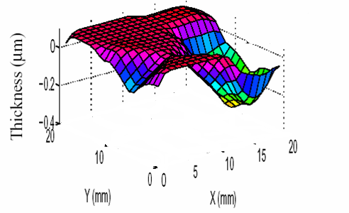
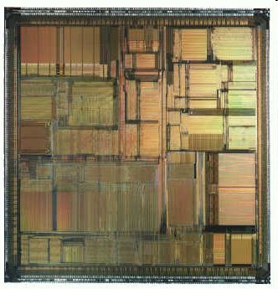
Runtime Verification: Technology Push
Parametric Variability
(Uncertainty in device and environment)
Transient Faults due to
Cosmic Rays & Alpha Particles
(Increase exponentially with
number of devices on chip)
Intra-die variations in ILD thickness
Figure Source: T. Austin
Dynamic errors which occur at runtime
Will need runtime solutions
Combine with runtime solutions for functional errors (design bugs)
Notes:
Challenges we need to deal with as we approach the end-of-the-road for silicon.
While some do not appear on their face to be reliability concerns (e.g., variability and design errors), many of the mechanisms we are proposing deal with these critical issues as well.

Slide 12
Runtime Verification: Challenges
What to check?
How to recover?
What’s the cost?
Discuss the above through specific micro-architecture case-studies in the uni- and multi-processor context.

Slide 13
Talk Outline
Motivation
Micro-Architectural Case-Studies
Connections with Formal Verification
Summary

Slide 14
Micro-architectural Case-Studies for Runtime Verification
Uni-processor Verification
  DIVA
    Todd Austin, Michigan
  Semantic Guardians
    Valeria Bertacco, Michigan
Multi-Processor Verification
  Memory Consistency
    Sharad Malik, Princeton
    Daniel Sorin, Duke
Recovery Mechanisms
  Checkpointing and Rollback
    Safety Net: Sorin, Hill, Wisconsin
    Revive: Josep Torellas, UIUC (Not Covered)
  Bug Patching
    Josep Torellas, UIUC
    FRiCLe: Valeria Bertacco, Michigan

Slide 15
DIVA Checker [Austin ’99]
speculative
instructions
in-order
with PC, inst,
inputs, addr
Core
Checker
EX/
MEM
IF
ID
REN
REG
SCHEDULER
CHK
CT
All core function is validated by checker
  Simple checker detects and corrects faulty results, restarts core
Checker relaxes burden of correctness on core processor
  Tolerates design errors, electrical faults, defects, and failures
  Core has burden of accurate prediction, as checker is 15x slower
Core does heavy lifting, removes hazards that slow checker
Notes:
…DIVA stands for “Dynamic Implementation Verification Architecture”…

Slide 16
Checker Processor Architecture
PC
PC
IF
inst
core PC
=
I-cache
Core
Processor
Prediction
Stream
inst
ID
regs
=
commit
core inst
RF
OK
CT
regs
EX
res/addr
result
core regs
=
WT
addr
MEM
result
core res/addr/nextPC
D-cache
watchdog timer

Slide 17
Check Mode
PC
IF
inst
core PC
=
I-cache
Core
Processor
Prediction
Stream
inst
ID
regs
=
commit
core inst
RF
OK
CT
regs
EX
res/addr
result
core regs
=
WT
addr
MEM
result
core res/addr/nextPC
D-cache
watchdog timer

Slide 18
Recovery Mode
PC
PC
IF
inst
I-cache
inst
ID
regs
RF
CT
regs
EX
res/addr
result
addr
MEM
result
D-cache

Slide 19
How Can the Simple Checker Keep Up?
Slipstream
EX/
MEM
IF
ID
REN
REG
SCHEDULER
CHK
CT
Checker processor executes inside core processor’s slipstream
  fast moving air ⇒ branch predictions and cache prefetches
  Core processor slipstream reduces complexity requirements of checker
  Checker rarely sees branch mispredictions, data hazards, or cache misses

Slide 20
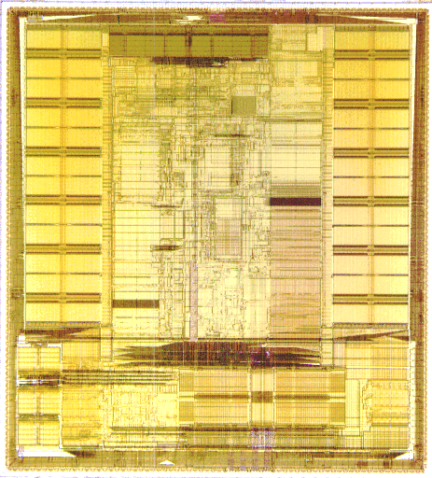
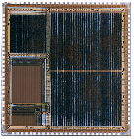
Checker Cost
Alpha 21264
REMORA
Checker
12 mm²
(in 0.25um)
205 mm²
(in 0.25um)
inst
cache
data
cache
pipe-
line
Formally Verified!
BIST
Performance < 5%
Area < 6%

Slide 21
Low-Cost Imperative
Further scaling
is not profitable
product
cost
1) Cost of built-in defect
tolerance mechanisms
2) Cost of R&D needed to
develop reliable technologies
Cost
reliability
cost
cost per
transistor
reliability
cost
Silicon Process Technology
Notes:
As silicon process technology scales deeper into the nanometer regime, hardware defects are becoming more common. Such defects are bound to hinder the correct operation of future processor systems, unless new online techniques become available to detect and to tolerate them while preserving the integrity of software applications running on the system. This effort proposes a new, software-based, defect detection and diagnosis technique, called BulletProof. We introduce a novel set of instructions, called Access-Control Extension (ACE), that can access and control the microprocessor's internal state. Special firmware periodically suspends microprocessor execution and uses the ACE instructions to run directed tests on the hardware. When a hardware defect is present, these tests can diagnose and locate it, and then activate system repair through resource reconfiguration. The software nature of our framework makes it flexible: testing techniques can be modified/upgraded in the field to trade off performance with reliability without requiring any change to the hardware. We evaluated our technique on a commercial chip-multiprocessor based on Sun's Niagara and found that it can provide very high coverage, with 99.22% of all silicon defects detected. Moreover, our results show that the average performance overhead of software-based testing is only 5.5%. Based on a detailed RTL-level implementation of our technique, we nd its area overhead to be quite modest, with only a 5.8% increase in total chip area.

Slide 22
Micro-architectural Case-Studies for Runtime Verification
Uni-processor Verification
  DIVA
    Todd Austin, Michigan
  Semantic Guardians
    Valeria Bertacco, Michigan
Multi-Processor Verification
  Memory Consistency
    Sharad Malik, Princeton
    Daniel Sorin, Duke
Recovery Mechanisms
  Checkpointing and Rollback
    Safety Net: Sorin, Hill, Wisconsin
    Revive: Josep Torellas, UIUC (Not Covered)
  Bug Patching
    Josep Torellas, UIUC
    FRiCLe: Valeria Bertacco, Michigan

Slide 23
Semantic Guardians [Wagner, Bertacco ’07]
Validated with
design-time
verification
Design state space
Static View
Dynamic View
Only a very small fraction of the design state space can be verified!
However, most of the runtime is spent in a few
frequent & verified states. Thus:
Verify at design-time the most frequent configurations
Detect at runtime when the system crosses the validated boundary
Use the inner core to walk through the unverified scenarios

Slide 24
Balancing Performance and Correctness

Slide 25
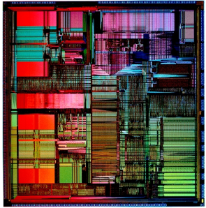
Semantic Guardian
Partition state space in trusted/untrusted (validated)
Synthesize Semantic Guardian (SG) from untrusted states (projected over critical signals)
@Runtime use SG to trigger inner-core mode
(formally verified complete subset of the design)
VALIDATION EFFORT
μprocessor
Area and performance can be traded-off with each other
trusted
trusted
Tape-out
SG

Slide 26
Micro-architectural Case-Studies for Runtime Verification
Uni-processor Verification
  DIVA
    Todd Austin, Michigan
  Semantic Guardians
    Valeria Bertacco, Michigan
Multi-Processor Verification
  Memory Consistency
    Sharad Malik, Princeton
    Daniel Sorin, Duke
Recovery Mechanisms
  Checkpointing and Rollback
    Safety Net: Sorin, Hill, Wisconsin
    Revive: Josep Torellas, UIUC (Not Covered)
  Bug Patching
    FRiCLeValeria Bertacco, Michigan
    Josep Torellas, UIUC

Slide 27
Checking Memory Consistency [Chen, Malik ’07]
Uniprocessor optimizations may break global consistency
  Program example
    Initial Values: A, B = 0
Memory consistency rules disallow such re-orderings!
Their implementation needs to be verified.
Processor-1
…
(1.1) A = 1;
(1.2) if (B == 0)
{
// critical section
…
Processor-2
…
(2.1) B = 1;
(2.2) if (A == 0)
{
// critical section
…
27
Notes:
27

Slide 28
Constraint Graph Model
A directed graph that models memory ordering constraints
  Vertices: dynamic memory instruction instances
  Edges:
    Consistency edges
    Dependence edges
[D. Shasha et al., TOPLAS’88]
[H. W. Cain et al., PACT’03]
A cycle in the graph indicates a memory ordering violation
P1
P2
P1
P2
P1
P2
P1
P2
P1
P2
P1
P2
ST A
ST A
ST A
ST A
ST A
ST A
LD A
LD A
LD A
LD A
LD A
LD A
ST B
ST B
ST B
ST B
ST B
ST B
ST A
MB
ST B
ST A
MB
LD D
ST B
ST A
LD D
LD B
ST B
LD D
LD C
LD C
LD C
LD C
LD C
LD C
ST C
ST C
ST C
ST C
ST C
ST C
ST A
ST A
ST A
ST A
ST A
ST A
LD A
LD A
LD A
Sequential Consistency
Total Store Ordering
Weak Ordering
28
Notes:
28

Slide 29
Extensions for Transactional Memory
Extended constraint graph for transaction semantics
  Non-transactional code assumes Sequential Consistency
P1
TransOpOp:
[Op1; Op2] => Op1 ≤ Op2
P2
LD A
LD A
ST B
TransMembar:
Op1; [Op2] => Op1 ≤ Op2
[Op1]; Op2 => Op1 ≤ Op2
TStart
TStart
ST C
LD C
ST D
LD D
TransAtomicity:
[Op1; Op2] ∧¬ [Op1; Op; Op2]
=>
(Op ≤ Op1) ∨ (Op2 ≤ Op)
TEnd
TEnd
LD B
ST A
ST F
LD E
29
Notes:
29

Slide 30
On-the-fly Graph Checking
DFS search based cycle
DFS search based cycle
Processor
Processor
Processor
checker for sparse graphs
Processor
Processor Core
checker for sparse graphs
Processor Core
Processor Core
Processor Core
Core
Core
Core
Core
Central
Central
Local
Local
Local
Local
Local
Local
Local
Graph
Local
Graph
Observer
Observer
Observer
Observer
Observer
Observer
Observer
L1 Cache
Observer
L1 Cache
L1 Cache
Checker
L1 Cache
L1 Cache
Checker
L1 Cache
L1 Cache
L1 Cache
Cache Controller
Cache Controller
Cache Controller
Cache Controller
Cache Controller
Cache Controller
Cache Controller
Cache Controller
Interconnection Network
Interconnection Network
Interconnection Network
Interconnection Network
L2 Cache
L2 Cache
L2 Cache
L2 Cache
Local observer:
- Local instruction ordering
- Local access history
- Locally observed inter-processor edges
Central checker:
- Build the global constraint graph
- Check for the acyclic property
30
Notes:
30

Slide 31
Practical Design Challenges
A naively built constraint graph that includes all executed memory instructions
  Billions of vertices
  Unbounded graph size
31
Notes:
31

Slide 32
Key Enabling Techniques
Graph Reduction
Graph Slicing
Enables checking of graphs of a few hundred vertices every 10K cycles
32
Notes:
32

Slide 33
Proofs through Lemmas [Meixner, Sorin ’06]
Divide and Conquer approach
  Determine conditions provably sufficient for memory consistency
  Verify these conditions individually
+ local checks
- false negatives
CPU
Core
Uniprocessor Ordering
Verify intra-processor value propagation
Legal Reordering
Verify operation order at cache is legal
Consistency model dependent
Cache
Memory
Single-Writer Multiple-Reader
Cache Coherence
Verify inter-processor data propagation and global ordering
Program Order Dependence Local Data Dependence Global Data Dependence

Slide 34
Micro-architectural Case-Studies for Runtime Verification
Uni-processor Verification
  DIVA
    Todd Austin, Michigan
  Semantic Guardians
    Valeria Bertacco, Michigan
Multi-Processor Verification
  Memory Consistency
    Sharad Malik, Princeton
    Daniel Sorin, Duke
Recovery Mechanisms
  Checkpointing and Rollback
    Safety Net: Sorin, Hill, Wisconsin
    Revive: Josep Torellas, UIUC (Not Covered)
  Bug Patching
    Josep Torellas, UIUC
    FRiCLe: Valeria Bertacco, Michigan

Slide 35
SafetyNet [Sorin et al. ’02]
CPU
reg CPs
cache(s)
CLB
memory
CLB
NS half
switch
network
interface
I/O bridge
EW half
switch
Checkpoint Log Buffer (CLB) at cache and memory
    Just FIFO log of block writes/transfers

Slide 36
Consistency in Distributed Checkpoint State
Most Recently
Validated Checkpoint
Processor
Recovery Point
Current
Memory
Checkpoint
Current
Memory
checkpoint
Current
Memory
Version
Active
(Architectural)
State of
System
Processor
Checkpoints Awaiting Validation
Need to account for in-flight messages in establishing consistent checkpoints
Checkpoint validation done in the background

Slide 37
Micro-architectural Case-Studies for Runtime Verification
Uni-processor Verification
  DIVA
    Todd Austin, Michigan
  Semantic Guardians
    Valeria Bertacco, Michigan
Multi-Processor Verification
  Memory Consistency
    Sharad Malik, Princeton
    Daniel Sorin, Duke
Recovery Mechanisms
  Checkpointing and Rollback
    Safety Net: Sorin, Hill, Wisconsin
    Revive: Josep Torellas, UIUC (Not Covered)
  Bug Patching
    Phoenix: Josep Torellas, UIUC
    FRiCLe: Valeria Bertacco, Michigan

Slide 38
Phoenix [Sarangi et al. ’06]
Design Defect
Dissecting a defect –
from errata documents
Non-Critical
Critical
Performance counters
Error reporting registers
Breakpoint support
Defects in memory, IO, etc.
Concurrent
Complex
All signals – same time
  (Boolean)
Different times
  (Temporal)

Slide 39
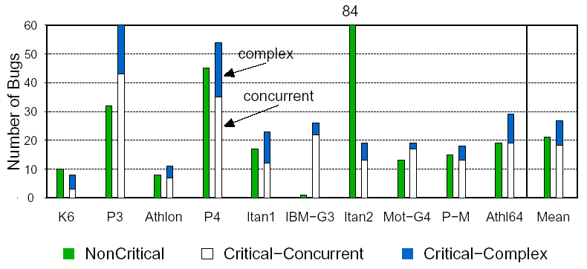
Characterization
31%
69%

Slide 40
Field Repairable Control Logic [Wagner et al. ’06]
State Matcher
  Ternary content-addressable memory
  Contains bug patterns
  Uses fixed bits and wildcards
  Switches system
  in/out of
  inner core
  mode
Recovery controller
State Matcher
Overhead:
performance: <5% (for bugs occurring < 1 out of 500 instr.)
area: < .02%
40
Notes:
Where in the pipeline it belongs, (show small pipeline and matchier IN IT). Put PSR in bold into picture

Slide 41
Talk Outline
Motivation
Micro-Architectural Case-Studies
Connections with Formal Verification
Summary

Slide 42
Runtime Checking of Temporal Logic Properties
assert always {!req; req} |=> {req[*0:2]; gnt}
Synthesize PSL Assertions to Automata (FoCs)
[Abarbanel et al. ’00]
req && !gnt
5
req && !gnt
!gnt
true
!req
req
4
1
2
3
!req && !gnt
6
!req && !gnt
Contrast with end-to-end correctness checks in the micro-architectural case-studies!
Synthesize Automata to Hardware
!gnt
req && !gnt
D
req && !gnt
req
D
!req
D
D
!req && !gnt
D
!req && !gnt
Example from [Boule & Zelic ‘08]

Slide 43
Offline vs. Runtime Verification
Offline Verification
  For all traces
  No design overhead
  Manage property/checker state
  Handling distributed state
Runtime Verification
  For actual trace
  Size/speed overhead
  Manage property/checker state
    Can reduce this based on specific trace
  Handling distributed state

Slide 44
Runtime Verification and Model Checking [Bayazit and Malik, ’05]
Use complementary strengths of runtime verification and model checking
  Runtime checking of abstractions
Model check
abstractions
Abstract A
Abstract B
Concrete
Design A
Concrete
Design B
Check abstractions
at runtime
Example: DIVA Processor Verification

Slide 45
Runtime Verification and Model Checking
Use complementary strengths of runtime verification and model checking
  Runtime checking of interfaces/assumptions
Model check
with interface assumptions
Interface
Assumptions
Concrete
Design A
Concrete
Design B
Check interface
at runtime

Slide 46
Talk Outline
Motivation
Micro-Architectural Case-Studies
Connections with Formal Verification
Summary

Slide 47
Summary Observations
Key Advantages
  Common framework for a range of defects
  Manage pre-silicon verification costs
    Have predictable verification schedules
    Support bug escapes through runtime validation
Complexity, Performance Tradeoffs
  Common mode
    High performance, high complexity
  (Infrequent) Recovery mode
    Low complexity, low performance
Leverage checkpointing support
  Backward error recovery through rollback
  Relevant for high-performance to support speculation

Slide 48
Summary Observations
Complementary Strengths
  Large state space
    Pre-silicon: Incomplete formal verification, simulation
    Runtime: Easy - observe only actual state
  State observability
    Runtime: Challenging to observe
      Distributed state, large number of variables
    Pre-Silicon: Easy – just variables in software models for simulation or formal verification
Challenges
  Keeping costs low, with increasing complexity and failure modes
  Checking the checker?
  A discipline for runtime validation?

Slide 49
So will this ever be real?
Design Costs in $M
Design Starts (first 5 years)
Can we afford not to have an
on-chip insurance policy?
Source: Douglas Grose
DAC 2010 Keynote

Slide 50
Acknowledgements
Several slides and other material provided by:
  Todd Austin
  Valeria Bertacco
  Harry Foster
  Divjyot Sethi
  Daniel Sorin
  Josep Torellas

Slide 51
References
Austin, T. M. 1999. DIVA: a reliable substrate for deep submicron microarchitecture design. In Proceedings of the 32nd Annual ACM/IEEE international Symposium on Microarchitecture (Haifa, Israel, November 16 - 18, 1999). International Symposium on Microarchitecture. IEEE Computer Society, Washington, DC, 196-207
Wagner, I. and Bertacco, V. 2007. Engineering trust with semantic guardians. In Proceedings of the Conference on Design, Automation and Test in Europe (Nice, France, April 16 - 20, 2007). Design, Automation, and Test in Europe. EDA Consortium, San Jose, CA, 743-748.
Kaiyu Chen; Malik, S.; Patra, P.; , "Runtime validation of memory ordering using constraint graph checking," High Performance Computer Architecture, 2008. HPCA 2008. IEEE 14th International Symposium on , vol., no., pp.415-426, 16-20 Feb. 2008
doi: 10.1109/HPCA.2008.4658657
URL: http://ieeexplore.ieee.org/stamp/stamp.jsp?tp=&arnumber=4658657&isnumber=4658618
Meixner, A.; Sorin, D.J.; , "Dynamic Verification of Memory Consistency in Cache-Coherent Multithreaded Computer Architectures," Dependable Systems and Networks, 2006. DSN 2006. International Conference on , vol., no., pp.73-82, 25-28 June 2006
doi: 10.1109/DSN.2006.29
URL: http://ieeexplore.ieee.org/stamp/stamp.jsp?tp=&arnumber=1633497&isnumber=34248
Prvulovic, M., Zhang, Z., and Torrellas, J. 2002. ReVive: cost-effective architectural support for rollback recovery in shared-memory multiprocessors. In Proceedings of the 29th Annual international Symposium on Computer Architecture(Anchorage, Alaska, May 25 - 29, 2002). International Symposium on Computer Architecture. IEEE Computer Society, Washington, DC, 111-122. URL= http://portal.acm.org/citation.cfm?id=545215.54522

Slide 52
References
Sorin, D. J., Martin, M. M., Hill, M. D., and Wood, D. A. 2002. SafetyNet: improving the availability of shared memory multiprocessors with global checkpoint/recovery. In Proceedings of the 29th Annual international Symposium on Computer Architecture (Anchorage, Alaska, May 25 - 29, 2002). International Symposium on Computer Architecture. IEEE Computer Society, Washington, DC, 123-134. URL= http://portal.acm.org/citation.cfm?id=545215.545229
Sarangi, S. R., Tiwari, A., and Torrellas, J. 2006. Phoenix: Detecting and Recovering from Permanent Processor Design Bugs with Programmable Hardware. In Proceedings of the 39th Annual IEEE/ACM international Symposium on Microarchitecture (December 09 - 13, 2006). International Symposium on Microarchitecture. IEEE Computer Society, Washington, DC, 26-37. DOI= http://dx.doi.org/10.1109/MICRO.2006.41
Wagner, I., Bertacco, V., and Austin, T. 2006. Shielding against design flaws with field repairable control logic. InProceedings of the 43rd Annual Design Automation Conference (San Francisco, CA, USA, July 24 - 28, 2006). DAC '06. ACM, New York, NY, 344-347. DOI= http://doi.acm.org/10.1145/1146909.1146998
Abarbanel, Y., Beer, I., Glushovsky, L., Keidar, S., and Wolfsthal, Y. 2000. FoCs: Automatic Generation of Simulation Checkers from Formal Specifications. In Proceedings of the 12th international Conference on Computer Aided Verification (July 15 - 19, 2000). E. A. Emerson and A. P. Sistla, Eds. Lecture Notes In Computer Science, vol. 1855. Springer-Verlag, London, 538-542.
Bayazit, A. A. and Malik, S. 2005. Complementary use of runtime validation and model checking. In Proceedings of the 2005 IEEE/ACM international Conference on Computer-Aided Design (San Jose, CA, November 06 - 10, 2005). International Conference on Computer Aided Design. IEEE Computer Society, Washington, DC, 1052-1059.

