Slide 1
Succinct Representation of Concurrent Trace Sets
Thorsten Tarrach
Joined work with:
Ashutosh Gupta, Thomas A. Henzinger, Arjun Radhakrishna and Roopsha Samanta

Slide 2
Problem setting
Input: Concurrent program with specification (assertions)
No assertion violated in preemption-free execution
Assertion is violated in concurrent execution
Output: Modified program where no assertion is ever violated
Add locks
Barriers
Wait-notifies
(Reorderings)

Slide 3
Synthesis loop
Input program
Program
Model checker
correct
yes
Synthesis
Output program
no
Faulty trace

Slide 4
Example: Programs and traces
Program
Bad trace
Bad execution
init: x = balance, deposited=0,
withdrawn=0
thread_withdraw
W1: t1 := balance
W2: balance := t1 – withdrawal
W3: withdrawn := 1
thread_deposit
D1: t2 := balance
D2: balance := t2 + deposit
D3: deposited := 1
thread_check
C1: assume(deposited=1 ∧
withdrawn=1)
C2: assert(balance = x+deposit
-withdrawal)
withdrawal = 1, deposit = 1
x=balance=0, deposited=0, withdrawn=0
W1: t1 := balance
t1 = 0
D1: t2 := balance
t2 = 0
W2: balance := t1 – withdrawal
balance = -1
W3: withdrawn := 1
widthdrawn = 1
D2: balance := t2 + deposit
balance = 1
D3: deposited := 1
deposited = 1
C1: assume(deposited=1 ∧ withdrawn=1)
C2: assert(balance = x+deposit-withdrawal)

Slide 5
Previous method
Program
Total order
init: x = balance, deposited=0,
withdrawn=0
thread_withdraw
W1: t1 := balance
W2: balance := t1 – withdrawal
W3: withdrawn := 1
thread_deposit
D1: t2 := balance
D2: balance := t2 + deposit
D3: deposited := 1
thread_check
C1: assume(deposited=1 ∧
withdrawn=1)
C2: assert(balance = x+deposit
-withdrawal)
W1
D1
W2
D2
W3
D3

Slide 6
Previous method
Program
Partial order
init: x = balance, deposited=0,
withdrawn=0
thread_withdraw
W1: t1 := balance
W2: balance := t1 – withdrawal
W3: withdrawn := 1
thread_deposit
D1: t2 := balance
D2: balance := t2 + deposit
D3: deposited := 1
thread_check
C1: assume(deposited=1 ∧
withdrawn=1)
C2: assert(balance = x+deposit
-withdrawal)
W1
D1
W2
D2
W3
D3

Slide 7
Previous method
Program
Bad trace
init: x = balance, deposited=0,
withdrawn=0
thread_withdraw
W1: t1 := balance
W2: balance := t1 – withdrawal
W3: withdrawn := 1
thread_deposit
D1: t2 := balance
D2: balance := t2 + deposit
D3: deposited := 1
thread_check
C1: assume(deposited=1 ∧ withdrawn=1)
C2: assert(balance = x+deposit-withdrawal)
thread_1
A1: y = 1
A2: y = 2
thread_2
B1: y = 3
W1: t1 := balance
D1: t2 := balance
W2: balance := t1 – withdrawal
W3: withdrawn := 1
D2: balance := t2 + deposit
D3: deposited := 1
A1: y = 1
B1: y = 3
A2: y = 2
C1: assume(deposited=1 ∧ withdrawn=1)
C2: assert(balance = x+deposit-withdrawal)
A1
B1
A2

Slide 8
Previous method
Program
Partial order
init: x = balance, deposited=0,
withdrawn=0
thread_withdraw
W1: t1 := balance
W2: balance := t1 – withdrawal
W3: withdrawn := 1
thread_deposit
D1: t2 := balance
D2: balance := t2 + deposit
D3: deposited := 1
thread_check
C1: assume(deposited=1 ∧ withdrawn=1)
C2: assert(balance = x+deposit-withdrawal)
thread_1
A1: y = 1
A2: y = 2
thread_2
B1: y = 3
W1
D1
A1
B1
W2
D2
A2
W3
D3

Slide 9
Trace separation
Input:
Single faulty trace (from a model checker etc.)
Output:
Happens-before formula, describing all bad traces in the neighbourhood
Applications for Happens-before formulae
Synthesis
Fault localisation & characterisation
Improving CEGAR loop

Slide 10
Example: Programs and traces
Program
Traces
init: x = balance, deposited=0,
withdrawn=0
thread_withdraw
W1: t1 := balance
W2: balance := t1 – withdrawal
W3: withdrawn := 1
thread_deposit
D1: t2 := balance
D2: balance := t2 + deposit
D3: deposited := 1
thread_check
C1: assume(deposited=1 ∧
withdrawn=1)
C2: assert(balance = x+deposit
-withdrawal)
Infeasible traces
Good
traces
Bad traces

Slide 11
Example: Programs and traces
Program
Formulas
init: x = balance, deposited=0,
withdrawn=0
thread_withdraw
W1: t1 := balance
W2: balance := t1 – withdrawal
W3: withdrawn := 1
thread_deposit
D1: t2 := balance
D2: balance := t2 + deposit
D3: deposited := 1
thread_check
C1: assume(deposited=1 ∧ withdrawn=1)
C2: assert(balance = x+deposit-withdrawal)
Exact representation of bad traces:
hb(W1,D2) ∧ hb(D1,W2) ∧ hb(W3,C1) ∧ hb(D3,C1)
W1
D1
W2
D2
W3
D3
C1
C2

Slide 12
Example: Programs and traces
Program
Formulas
init: x = balance, deposited=0,
withdrawn=0
thread_withdraw
W1: t1 := balance
W2: balance := t1 – withdrawal
W3: withdrawn := 1
thread_deposit
D1: t2 := balance
D2: balance := t2 + deposit
D3: deposited := 1
thread_check
C1: assume(deposited=1 ∧ withdrawn=1)
C2: assert(balance = x+deposit-withdrawal)
Sound overapproximation of bad traces:
hb(W1,D2) ∧ hb(D1,W2)
W1
D1
C1
W2
D2
C2
W3
D3

Slide 13
Example: Programs and traces
Program
Formulas
init: x = balance, deposited=0,
withdrawn=0
thread_withdraw
W1: t1 := balance
W2: balance := t1 – withdrawal
W3: withdrawn := 1
thread_deposit
D1: t2 := balance
D2: balance := t2 + deposit
D3: deposited := 1
thread_check
C1: assume(deposited=1 ∧ withdrawn=1)
C2: assert(balance = x+deposit-withdrawal)
Exact representation of good traces:
(hb(D2,W1) ∨ hb(W2,D1)) ∧ hb(W3,C1) ∧ hb(D3,C1)
W1
D1
or
W2
D2
W3
D3
C1
C2

Slide 14
Example: Programs and traces
Program
Formulas
init: x = balance, deposited=0,
withdrawn=0
thread_withdraw
W1: t1 := balance
W2: balance := t1 – withdrawal
W3: withdrawn := 1
thread_deposit
D1: t2 := balance
D2: balance := t2 + deposit
D3: deposited := 1
thread_check
C1: assume(deposited=1 ∧ withdrawn=1)
C2: assert(balance = x+deposit-withdrawal)
Sound overapproximation of good traces:
hb(D2,W1) ∨ hb(W2,D1)
W1
D1
C1
or
W2
D2
C2
W3
D3

Slide 15
Exact Algorithm
$Φ←Φ_{CTP}$
$φB← false$
while $Φ$ satisfiable
$V←$partial satisfying assignment (model) of $Φ$
$φB← φ_{B}∨\bigwedge{\left\{hb\left(e,e^{′}\right)|V⊨hb(e,e^{′})\right\}}$
$Φ←Φ∧¬φ_{B}$
return $φ_{B}$
This basically enumerates all bad traces
[1] C. Wang, S. Kundu, M. Ganai, and A. Gupta. Symbolic predictive
analysis for concurrent programs. In FM, pages 256–272. 2009

Slide 16
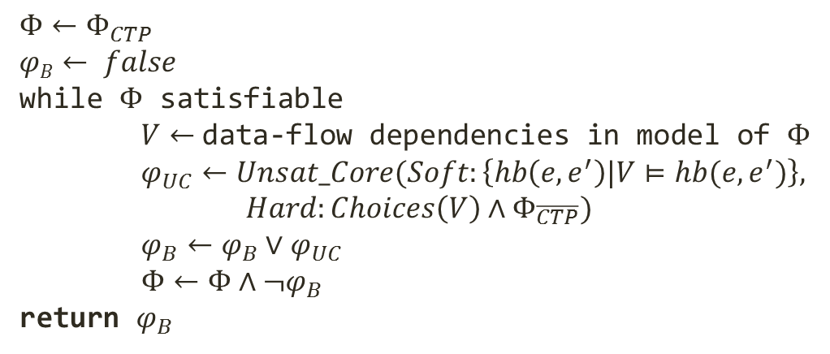
Approximation Algorithm
$Φ←Φ_{CTP}$
$φB← false$
while $Φ$ satisfiable
$V←$data-flow dependencies in model of $Φ$
$φ_{UC}←Unsat_Core(Soft:\left\{hb\left(e,e^{′}\right)|V⊨hb(e,e^{′})\right\},$ $$Hard:Choices\left(V\right)∧Φ_{\overline{CTP}})$$
$φ_{B}←φ_{B}∨φ_{UC}$
$Φ←Φ∧¬φ_{B}$
return $φ_{B}$

Slide 17
Unsat core optimisation
Program
Partial order
init: x = balance, deposited=0,
withdrawn=0
thread_withdraw
W1: t1 := balance
W2: balance := t1 – withdrawal
W3: withdrawn := 1
thread_deposit
D1: t2 := balance
D2: balance := t2 + deposit
D3: deposited := 1
thread_check
C1: assume(deposited=1 ∧ withdrawn=1)
C2: assert(balance = x+deposit-withdrawal)
thread_1
A1: y = 1
A2: y = 2
thread_2
B1: y = 3
W1
D1
A1
B1
W2
D2
A2
W3
D3

Slide 18
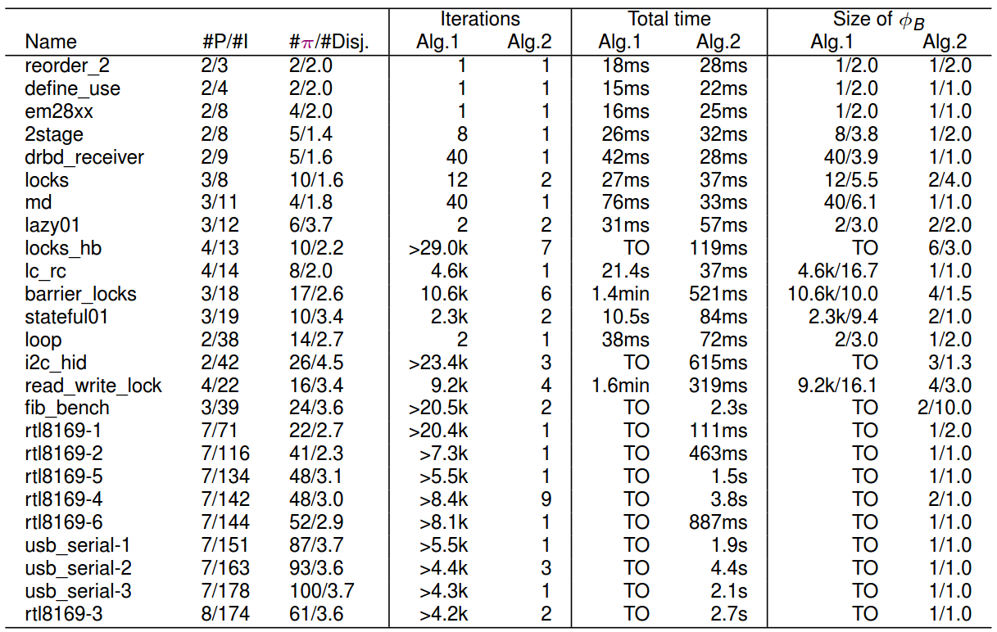
Implementation TARA

Slide 19
Application: Synthesis
We can infer locks, barriers and wait-notifies
Use formula of good traces
Bring into CNF
For each conjunct
Apply rewrite rules
X_{i}
Y_{k}
or
X_{j}
Y_{l}

Slide 20
Synthesis Example
Program
Formulas
init: x = balance, deposited=0,
withdrawn=0
thread_withdraw
W1: t1 := balance
W2: balance := t1 – withdrawal
W3: withdrawn := 1
thread_deposit
D1: t2 := balance
D2: balance := t2 + deposit
D3: deposited := 1
thread_check
C1: assume(deposited=1 ∧ withdrawn=1)
C2: assert(balance = x+deposit-withdrawal)
Sound overapproximation of good traces:
hb(D2,W1) ∨ hb(W2,D1)
W1
D1
or
W2
D2
W3
D3

Slide 21
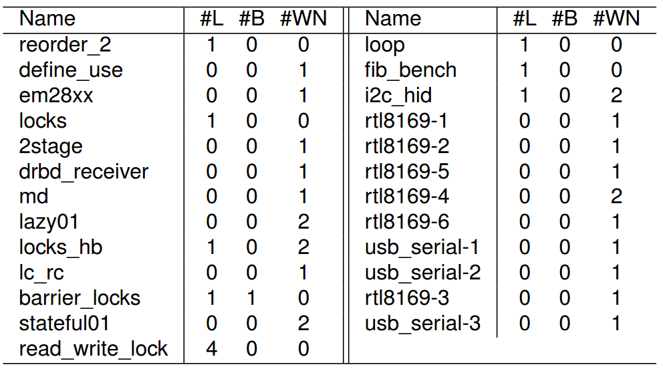
Synthesis results

Slide 22
Application: Bug summarisation
We can detect
data race bugs
atomicity violation
define-use bugs
two stage access bugs
We use the DNF of bad traces
l₁’
l₂’
read(v)
read(v)
l₁’’
l₂’’
write(v)
write(v)

Slide 23
Bug summarisation example
Program
Formulas
init: x = balance, deposited=0,
withdrawn=0
thread_withdraw
W1: t1 := balance
W2: balance := t1 – withdrawal
W3: withdrawn := 1
thread_deposit
D1: t2 := balance
D2: balance := t2 + deposit
D3: deposited := 1
thread_check
C1: assume(deposited=1 ∧ withdrawn=1)
C2: assert(balance = x+deposit-withdrawal)
Sound overapproximation of bad traces:
hb(W1,D2) ∧ hb(D1,W2)
read(bal)
W1
D1
read(bal)
write(bal)
W2
D2
write(bal)
W3
D3
➔ data-race bug

Slide 24
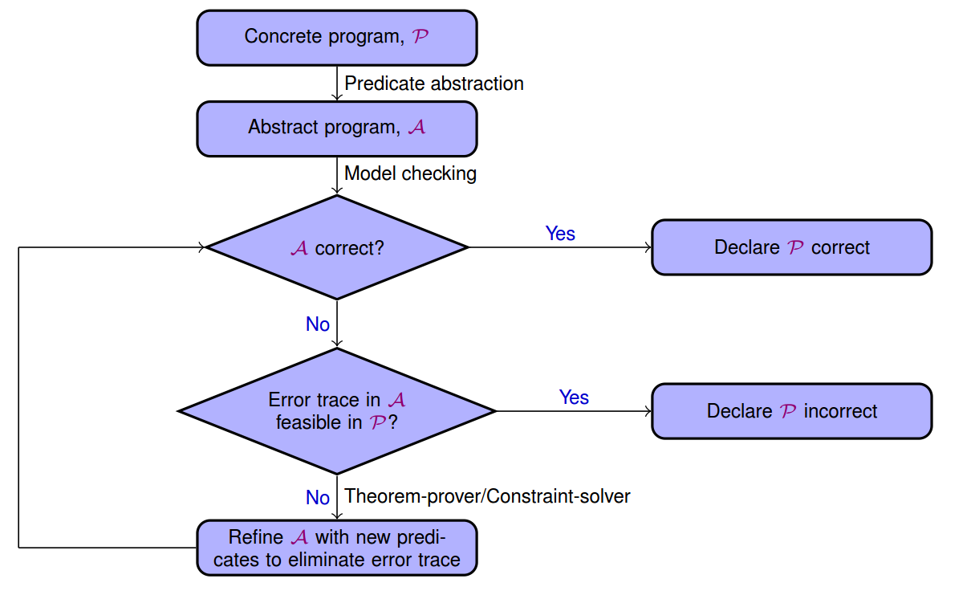
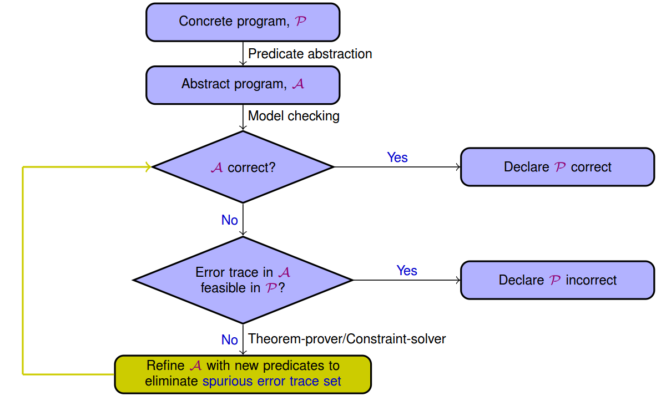
Application CEGAR acceleration

Slide 25
Summary
A method and a tool to obtain succinct representations of trace neighbourhoods
Captures the “reason” for the error
Three applications
Synthesis
Bug summarisation
CEGAR acceleration

Slide 26
Parts of Phi_CTP
Program
$$Φ_{po}$$
$$Φ_{vd}$$
init: x=0
A: assume(x=0)
B: x:=1 Z: x:=2
C: assert(x=1)
$$A<B∧B<C$$
$$x_{B}=1∧x_{Z}=2$$
$$Φ_{pre}$$
$$Φ_{prp}$$
$${¬Φ}_{prp}$$
$$x_{i}=0$$
$$x_{A}=1⟹x_{C}=2$$
$$x_{A}=1∧x_{C}≠2$$
$$Φ_{pi}$$
$$\left[\left(x_{A}=x_{i}∧A<Z\right)∨\left(x_{A}=x_{Z}∧Z<A\right)\right] \\ [\left(x_{C}=x_{B}∧(Z<B∨C<Z)\right)∨(x_{C}=x_{Z}∧B<Z∧Z<C)]$$
$$Φ_{CTP}=Φ_{po}∧Φ_{vd}∧Φ_{pre}∧Φ_{pi}∧¬Φ_{prp}$$

